Slide 1
Async development with Unity
an approach to async development by Javier Peña

Slide 2

The Async Mindset
"Waiting vs. Blocking"
Synchronous: The task blocks the main thread.
Coroutine: Checking every chunk of time if a task is done.
Async/Await: Gets notify when the task is completed.
Notes:
Real-world analogy.
Synchronous: You stand at a coffee shop counter and stare at the barista until your latte is done. You can't check your phone; you are "blocked." (This is a long loop on the Main Thread that freezes the game).
Coroutine: You check back every few seconds to see if the latte is ready. You are doing other things, but you are still tied to the shop's schedule.
Async/Await: You get a buzzer. You go sit down, work on your laptop, and the moment the buzzer vibrates (the Task completes), you pick up exactly where you left off.

Slide 3
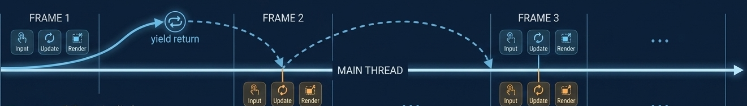
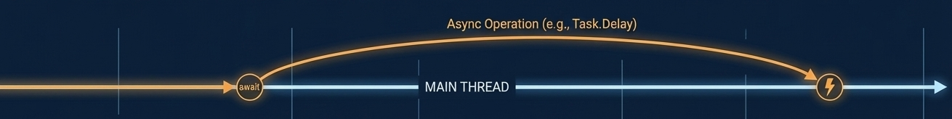
The Async Mindset
"Frame-Based" vs. "Task-Based" Paradigm
Coroutines are sequential interruptions. They say: "Stop here, let the engine render a frame, then come back to this exact line."
Tasks are promises of completion. They say: "Start this operation. I don't care how many frames it takes or what thread it runs on; just notify me when the result is ready."

Slide 4
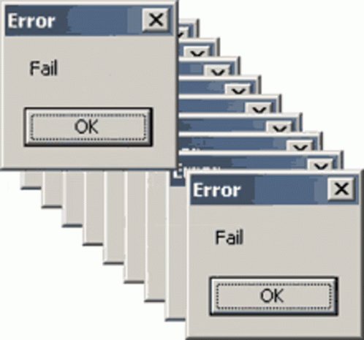
The Async Mindset
"Ghost in the Machine" (The Danger)
Coroutines are tied to a MonoBehaviour
Tasks are tied to the C# Runtime
The Golden Rule: "In Unity, an Async Task without a CancellationToken is a memory leak waiting to happen."
Notes:
Avoid the "Thread" Trap: Clarify that async does not always mean "New Thread." Most Unity web requests or delays stay on the Main Thread but use a "non-blocking" wait.
The Return Value Revolution: Highlight that Coroutines cannot easily return data (you need Action<T> callbacks). Tasks return Task<T>, making code look like standard synchronous logic: var data = await DownloadData();.

Slide 5
The Syntax
Concept | Coroutine (IEnumerator) | Async (async Task)
Signature | IEnumerator MyMethod() | async Task MyMethod()
Pause | yield return new WaitForSeconds(1f); | await Task.Delay(1000); (Note: ms)
Wait for Other | yield return StartCoroutine(Other()); | await Other();
Return Value | ❌ (Callbacks required) | return myValue;
Error Handling | ❌ (Stops silently) | try { ... } catch (Exception e) { ... }
async void vs async Task : Which one we should use?
Notes:
The "One Rule to Rule Them All": async void vs async Task You must emphasize this distinction immediately, or they will write buggy code.
async Task: The standard. Use this for 99% of your methods. It allows the caller to await it and catch errors.
async void: The Danger Zone. Only use this for Event Handlers (like Unity Lifecycle methods Start, Update or UI Buttons).
Why? If an async void method crashes, the exception is often swallowed or crashes the app without a stack trace.

Slide 6

CancellationTokens
CancellationTokenSource: The boss. It decides when to cancel.
CancellationToken: The letter. It gets passed down to every worker (Task).
destroyCancellationToken: Monobehaviour default token.
Never write a Task without an "Exit Strategy".

Slide 7
Awaitable
Feature | Standard Task | Unity Awaitable
Return Type | async Task / async Task<T> | async Awaitable / async Awaitable<T>
Namespace | System.Threading.Tasks | UnityEngine
Performance | High GC Allocation ⚠️ | Zero Allocation (Pooled) 🚀
Threading | Context needs manual marshalling Task.Run(()=> {...}); | Engine-aware (Auto-switching) await Awaitable.BackgroundThreadAsync(); / await Awaitable.MainThreadAsync();

Slide 8
Awaitable vs Task vs void
🟢 async Awaitable: Optimized, safe, native to Unity (2023+).
Pros:
  Zero Allocation: It uses object pooling. No GC spikes.
  Thread Safety: It captures Unity's context automatically (switching between C++ engine threads and C# script threads).
Cons: Doesn't have all the fancy utility methods of Task (yet).
🟡 async Task: Standard, reliable, works everywhere, but slightly heavier (GC allocation).
Pros: Rich API (Task.WhenAll, Task.WhenAny), standard error handling.
Cons: Garbage Collection (GC). Every Task you create allocates memory on the heap. In a tight loop (like pathfinding), this causes lag spikes.
🔴 async void: Dangerous. No return ticket. Use only when forced (events).

Slide 9
The Task Orchestration
Task.WhenAll: Runs everything in parallel.
Task.WhenAny: Runs everything in parallel.
Task.Delay: Pauses the Method, frees the Thread.
Task.CompletedTask: Returns a task that is already done.
Task.FromResult(T): Creates a task wrapped around a pre-calculated value.
Task.Yield(): Forces the method to yield execution back to the caller and schedule the rest for later.
What if we want an extent API like Task but with no allocation like Awaitable?
I present UniTask

Slide 10
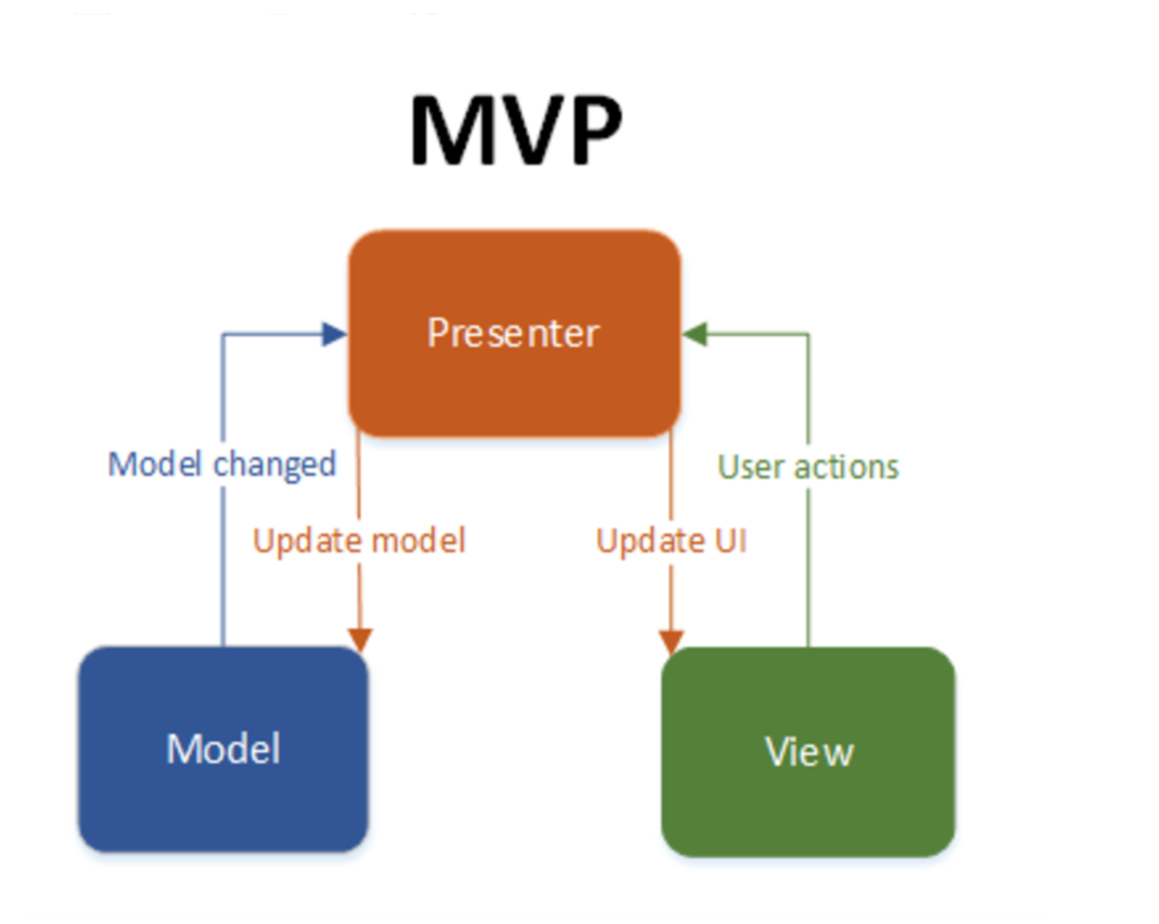
MVP
1. The Concept Diagram
VIEW (MonoBehaviour): Handles UI references, Input, and Lifecycle (Cancellation)
PRESENTER (Pure C#): Orchestrates the Logic. "Show Loading" → "Call Service" → "Update UI".
MODEL (Service): Pure Async Data fetching.

